Slide 1
CS60055: Ubiquitous Computing
Energy Harvesting

Slide 2
Low Power Autonomous Devices
Connected low-powered devices are the backbone behind majority of the ubiquitous systems
  Sensing and actuation (Conventional IoT devices)
  Supports on-board ML for inferences (TinyML)
  Edge devices with GPU support (Nvidia JetSon)
Powered by on-device power supply
  Currently realized by various types and sizes of batteries depending on the application requirements
Power sources become one of the major performance bottleneck
  batteries store a finite amount of energy – needs recharging or replacement

Slide 3
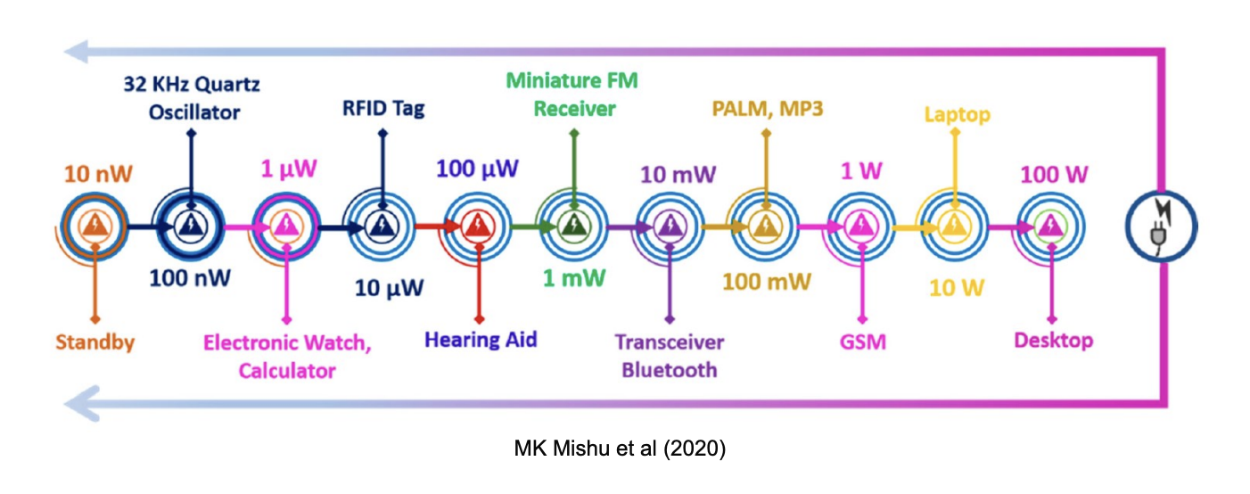
Low Power Autonomous Devices
Various applications demand constant power sources which are unlikely to be available
  Example: Biodiversity monitoring (animals in a forest, fishes in the sea)
Given the limited lifespan of batteries, we need alternative power sources
Power requirements for typical IoT devices:

Slide 4
Power Autonomy Challenges
Use non-conventional energy sources (along with harvesting)
  Example: Solar energy
Energy harvesting as a potential energy source
  Thermal energy harvesting
  Solar energy harvesting
  Vibration (piezoelectric) energy harvesting
  Kinetic (mechanical) energy harvesting
  Inductive (electromagnetic induction) energy harvesting
  Ambient Light Energy Harvesting (Indoor Light Harvesting)
  Electrostatic Energy Harvesting
  Magnetic Field Energy Harvesting
  RF (Radio Frequency) Energy Harvesting
  ...

Slide 5
Radio Frequency Energy Harvesting
Captures ambient radio frequency energy and converts it into usable electrical power
Use the available RF devices for energy harvesting
  GSM Antennas
  Radios
  WiFi devices
  TV Broacast
  …
Typically used in a scenario where many RF sources are available in the area
  Advantage: "Free" energy source
  Challenges: Low power density and variable/unpredictable power

Slide 6
How RF Energy Harvesting Works
Antenna: Responsible for capturing RF signals from the surrounding environment
  Typically captures a specific predefined frequency (say, 5GHz WiFi)
  Multiband antennas can capture signals from multiple frequency bands
Matching Network: Connects the antenna to the rectifier and maximizes power transfer
  Adjusts impedance to ensure that the maximum possible RF power is delivered from the antenna to the rectifier
Rectifier (AC-to-DC Conversion): Converts the captured RF signal into DC power
  RF energy is AC, while most electronic devices require DC

Slide 7
How RF Energy Harvesting Works
Energy Storage/Management Circuit: The harvested energy is typically stored in a small capacitor, rechargeable battery, or supercapacitor to provide stable power to a device
  Regulates the power output and ensures stable voltage for the device.
Loads (Device): The device or circuit that uses the harvested energy

Slide 8
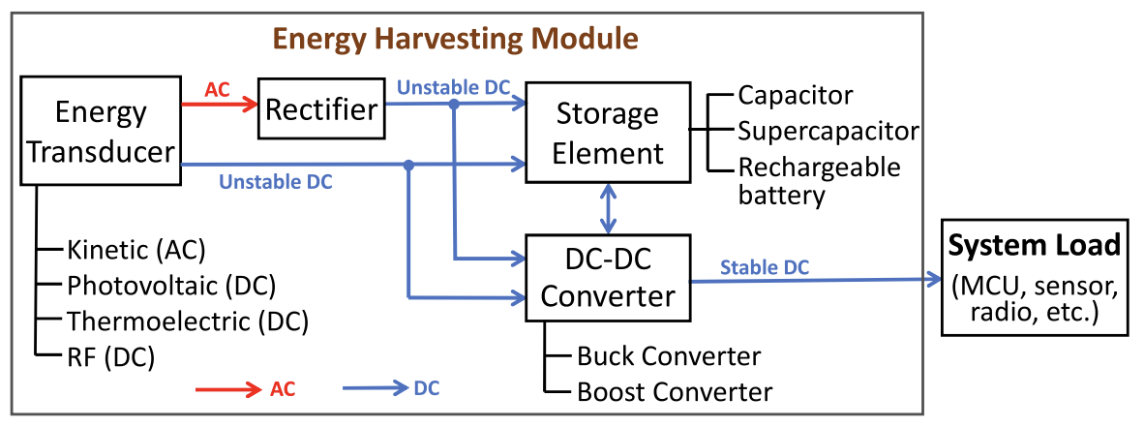
Energy Harvesting Network
Source: https://ieeexplore.ieee.org/stamp/stamp.jsp?tp=&arnumber=8944276

Slide 9
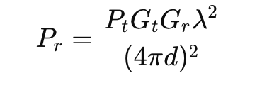
Principle of RF Energy Harvesting
The power received by an RF energy harvesting antenna depends on several factors
  Distance from the RF source
  frequency of the signal
  …
Friis Transmission Equation provides the power received (P_{r}) by an antenna from an RF source:
  P_{t} is the transmit power of the RF source in watts
  G_{t} is the gain of the transmitting antenna
  G_{r} is the gain of the receiver antenna
  λ is the wavelength, and d is the distance between the transmitting and the receiving antennas

Slide 10


Principle of RF Energy Harvesting
The antenna efficiency (η) affects the power delivered to the rectifier
The Effective Power Captured by the antenna (P_{ant}) is:
  In practice, an impedance matching network is used to maximize power transfer from the antenna to the rectifier
  If the antenna and rectifier are perfectly matched, the maximum power is transferred; otherwise, power is reflected, reducing efficiency.
The rectifier converts the AC signal received from the antenna into DC power. The DC Power Output after rectification is computed as,
η_{r} is the rectifier efficiency

Slide 11
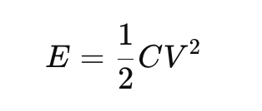
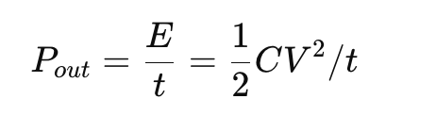
Principle of RF Energy Harvesting
To calculate the power available to the load or device, we consider both the rectifier’s output and any energy stored in capacitors or supercapacitors
Let C be the capacitance of the storage capacitor, and V be the output voltage across it. If the capacitor is charged to a voltage V over time t, the stored energy (E) is:
If the capacitor discharges to power a load, the average power delivered (P_{out}) can be computed as,

Slide 12
Battery-free Wireless Sensing
Use the wireless signal for joint sensing and energy harvesting
  The received signal can be used for analyzing the environment as well as the DC component of the signal can be used for energy harvesting

Slide 13
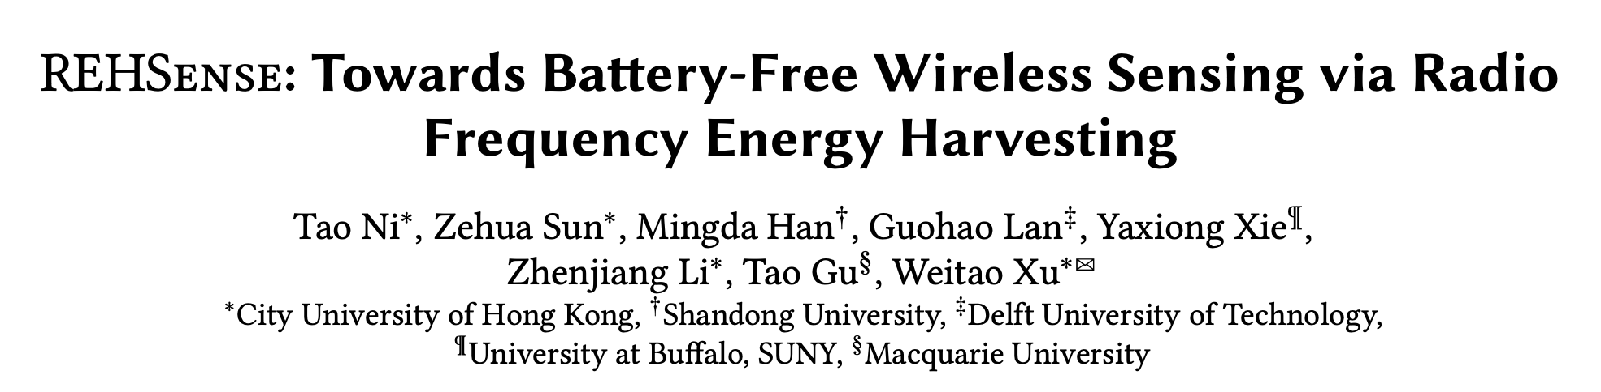
Battery-free Wireless Sensing
Use the wireless signal for joint sensing and energy harvesting
  The received signal can be used for analyzing the environment as well as the DC component of the signal can be used for energy harvesting
ACM MobiHoc 2024

Slide 14
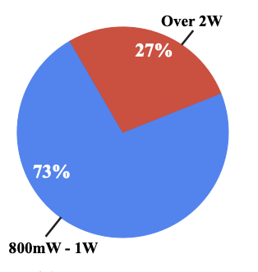
Challenges with WiFi Sensing
Not all WiFi cards support CSI extraction
  Most of the CSI-extractable NIC cards are no longer adopted by the latest Wi-Fi devices
  Needs additional hardware on the WiFi devices for CSI extraction
WiFi NICs consume a good amount of power

Slide 15
Challenges with WiFi Sensing
Not all WiFi cards support CSI extraction
  Most of the CSI-extractable NIC cards are no longer adopted by the latest Wi-Fi devices
  Needs additional hardware on the WiFi devices for CSI extraction
WiFi NICs consume a good amount of power
Use an energy harvester to power the NIC and sensing can be performed by extracting CSI information from the same RF signal

Slide 16
Core Idea
Human activity significantly affects the amount of energy that the harvester captures from the ambient RF signals
  Depending on the position and the pose of the human, the signal reflecting off the human body may superimpose constructively or deconstructively with multipath signals in the propagation environment at the harvester
  Leverage the RF energy harvester as a novel battery-free activity sensor
Measure the time-varying harvested power (voltage) as the sensing signal
  Apply a deep neural network to recognize various human activities

Slide 17
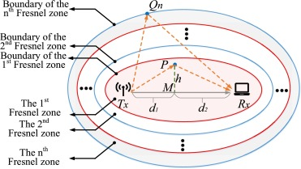
Fresnel Zone Diffraction Model
Divides the area around the direct LoS path between a transmitter and a receiver into a series of ellipsoidal zones called Fresnel zones
  Each zone represents an area where electromagnetic waves travel with different path lengths, resulting in constructive or destructive interference based on the phase differences at the receiver
Describes how obstacles in the
Fresnel zones affect signal
transmission
  Helps predict the signal strength
  and attenuation caused by diffraction,
  which occurs when an electromagnetic
  wave encounters an obstacle along its
  propagation path

Slide 18
Fresnel Zone Diffraction Model
First Fresnel Zone (FFZ): Contains most of the transmitted energy
  Keeping the first Fresnel zone clear of obstructions minimizes diffraction losses and allows for a stronger received signal
Higher-order Fresnel Zones: These alternate between causing constructive (odd-numbered zones) and destructive interference (even-numbered zones)
  Signals passing through these zones can interfere with each other at the receiver, depending on the path differences

Slide 19
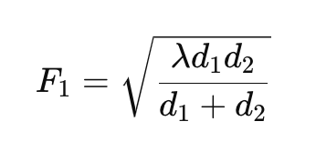
Fresnel Zone Diffraction Model
The radius of the first Fresnel zone at any point along the path between the transmitter and receiver can be calculated using

Slide 20
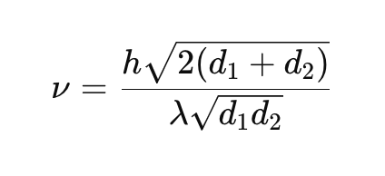
Fresnel Zone Diffraction Model
To estimate signal attenuation due to diffraction, the model uses a parameter called the Fresnel-Kirchhoff diffraction parameter (ν), which quantifies the impact of an obstacle on the signal:
  h is the height of the obstacle in meters

Slide 21
Fresnel Zone Diffraction Model
To estimate signal attenuation due to diffraction, the model uses a parameter called the Fresnel-Kirchhoff diffraction parameter (ν), which quantifies the impact of an obstacle on the signal:
  h is the height of the obstacle in meters
If 𝜈 <0.7: Minor obstruction, minimal diffraction loss.
If 𝜈≈1: Moderate obstruction, potential for significant diffraction loss.
If 𝜈>1: Severe obstruction, high diffraction loss, substantial signal attenuation.

Slide 22
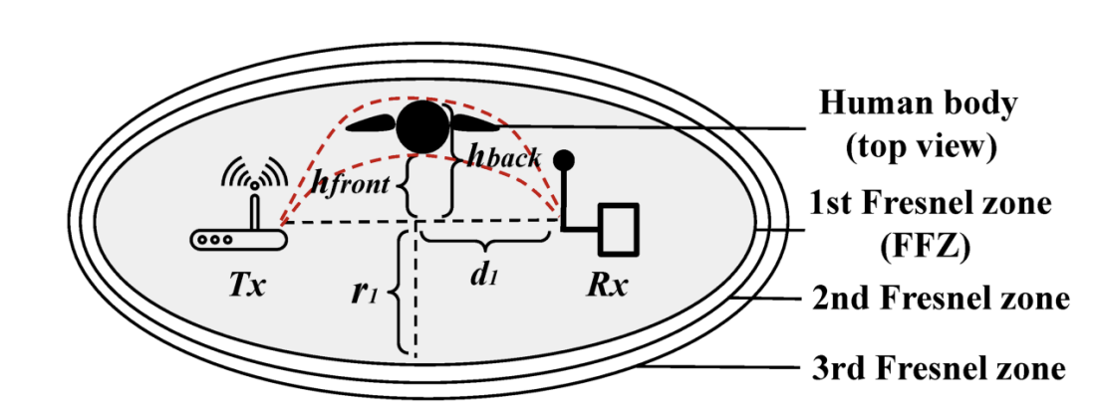
Impact of Human Subjects on the FFZ
Human subject on the FFZ will create signal diffraction
  The diffracted signals from the human body will attenuate with the Friis gain at the RF harvester

Slide 23
Impact of Human Subjects on the FFZ
The energy generated by the RF energy harvesting device is the combination of three factors
  Friis Gain (Free-space propagation)
  Diffraction Gain (Constructive attenuation from the FFZ)
  Path loss from the other objects (Constructive/destructive attenuation from other objects in the surroundings)

Slide 24
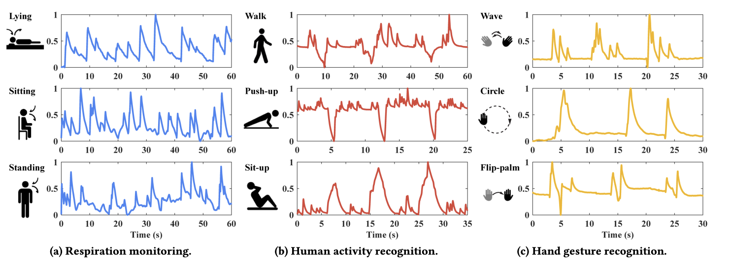
Harvested Voltage Signals for Variuous Activity Recognition Tasks

Slide 25
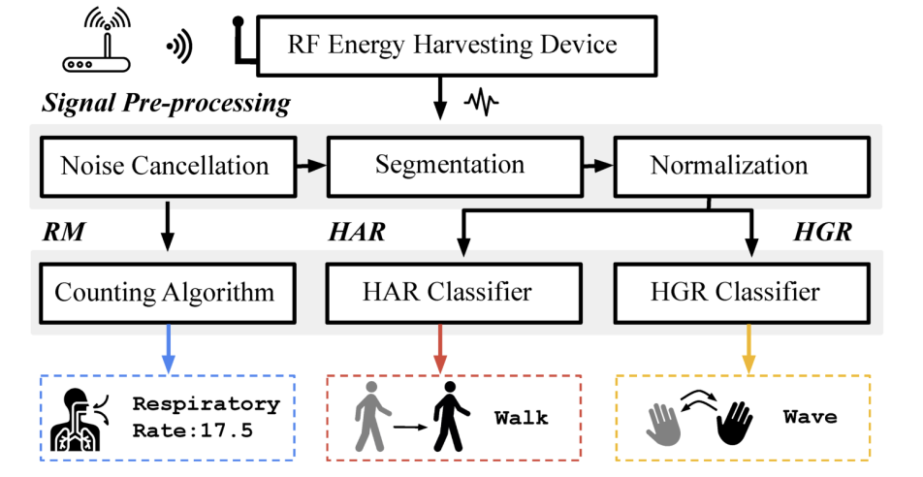
Overview of REHSense

Slide 26
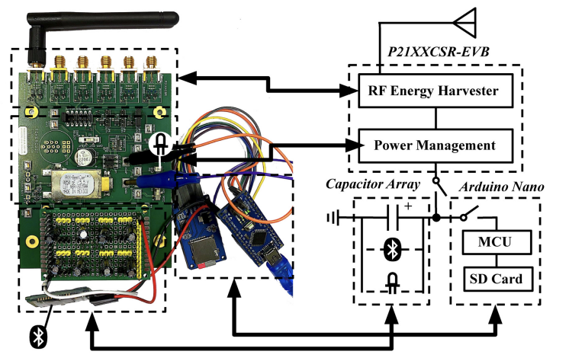
Battery Free Sensing System

Slide 27




Happy Learning!
Some resources related to this topic

